Slide 1
Visio-Voice (Transforming Images into Sound for the Visually Impaired)

Slide 2
Introduction
Visio-Voice leverages cutting-edge algorithms to analyze images and translate them into rich, descriptive auditory cues, providing a comprehensive understanding of the visual world.
The technology enables visually impaired individuals to navigate complex environments with greater confidence and independence, offering real-time feedback and guidance through sound.
By bridging the sensory gap between vision and hearing, Visio-Voice promotes inclusivity by ensuring that individuals with visual impairments can access and engage with visual information effectively.
This transformative tool not only enhances daily activities such as navigation, object recognition, and environmental awareness but also opens up new opportunities for participation and engagement in various settings.

Slide 3
Problem Definition
Problem Statement: Limited Accessibility for Visually Impaired Individuals
- Traditional digital media heavily relies on visual elements.
- Excludes individuals relying on auditory means for information.
Challenges: Lack of Efficient Solutions for Audio Descriptions
- Inadequate tools to convert visual content into accessible audio descriptions.
- Dependency on sighted assistance for information and entertainment.
Project Objective:
- Develop a technology-driven solution.
- Seamlessly convert images into audio descriptions.
Goals:
- Bridge the accessibility gap for visually impaired individuals.
- Enhance independence and inclusivity.
Outcome:
- Improved independence and inclusivity for the visually impaired community.
- Address the information gap through efficient audio description technology.

Slide 4
Literature Survey
S.No. | Authors name(s) | Full title of the paper with year | Inference from the paper | Open Problem (For proposed work)
1 | R. Sriram, R. Haralalka and J. R | Image to Audio Captioning for the Visually Impaired. 2023 | The proposed system utilizes a self-attention mechanism and transformer architecture to generate descriptive audio captions from images for visually impaired users. | Developing methods to further improve the efficiency and accuracy of image-to-audio captioning systems for visually impaired individuals.
2 | E.Mulyanto, E.I.Setiawan, E.M.Yuniarno M.H.Purnomo | Automatic Indonesian Image Caption Generation using CNN-LSTM Model and FEEH-ID Dataset. 2019 | The study introduces an Indonesian image captioning dataset, FEEH-ID, and demonstrates promising results using a CNN-LSTM model, highlighting the need for larger datasets to further enhance performance. | Enhancing the performance of image captioning models for languages with limited resources like Indonesian by augmenting dataset sizes.
3 | J. Sudhakar, V. V. Iyer S. T.Sharmila | Image Caption Generation using Deep Neural Networks.2022 | The study examines deep neural networks for image captioning, emphasizing speech conversion and the challenge of attaining human-like in machine-generated descriptions. | Improving the conciseness and naturalness of machine-generated image descriptions to match human language patterns.

Slide 5
Literature Survey
S.No. | Authors name(s) | Full title of the paper with year | Inference from the paper | Open Problem (For proposed work)
4 | S. Rao, S. Santhosh, K. Preethi Salian, T. Chidananda, Prathyakshini S. Sandeep Kumar | A Novel Approach to Generate the Captions for Images with Deep Learning using CNN and LSTM Model.2022 | The study suggests a new image captioning method with CNN and LSTM models, targeting automatic image tagging and potential surveillance applications to detect hazardous activities. | Developing techniques to enhance the accuracy and efficiency of automatic image captioning, particularly for real-time surveillance applications.
5 | A. S. Alva, R. Nayana, N. Raza, G. S. Sampatrao K. B. S. Reddy | Object Detection and Video Analyser for the Visually Impaired. 2021 | The study introduces a object detection and video analysis system for the visually impaired, offering real-time object recognition, video description, and distance estimation to improve environmental awareness. | Further refinement of real-time object recognition and distance estimation algorithms to improve accuracy and responsiveness in assisting visually impaired individuals.
6 | Renuga. K; Sree Nivethitha. K. N; Sri Aishwariya. R. S; Kingsy Grace. R | Deep Learning Based Voice Assistant for the Visually Impaired. 2023 | The study introduces a deep learning voice assistant for the visually impaired, using a CNN-RNN hybrid model with transfer learning and attention mechanisms for precise real-time environmental descriptions. | Enhancing the efficiency and naturalness of real-time environmental descriptions for visually impaired individuals through further refinement of deep learning models.

Slide 6
Literature Survey
S.No. | Authors name(s) | Full title of the paper with year | Inference from the paper | Open Problem (For proposed work)
7 | V. V. N. V. Phani Kumar, V. Phani Teja, A. R. Kumar, V. Harshavardhan and U. Sahith | Image Summarizer for the Visually Impaired Using Deep Learning. 2021 | The study presents an image summarization system for the visually impaired, combining a multilayer CNN for object recognition and an LSTM for creating meaningful image descriptions, with audio output for improved accessibility. | Enhancing the accuracy and naturalness of image summarization for visually impaired individuals through further optimization of deep learning models and audio output generation.
8 | F. Sharon, S. Sellamuthu, N. S and A. V | Framework for Face recognition and Scene Description using Deep Learning for Visually Challenged people. 2023 | The study introduces a comprehensive framework using deep learning techniques like Faster R-CNN, ResNet-50, and LSTM for face recognition, scene description, and object detection for visually impaired individuals. | Further optimization of deep learning models to enhance accuracy and efficiency in assisting visually challenged individuals, particularly in real-world scenarios.
9 | A. Uriti, D. P. Kakarla, D. Jinugu, K. N. Silla, K. T. V. N. S. Sai Krishna C. Anilkumar | A Survey on Generating Audio with Captions for a Live Video using Neural Networks. 2023 | The survey examines live video caption generation methods, highlighting the importance of accurate, generalized captions and audio output for aiding visually impaired individuals. It aims to analyze current approaches and suggest future directions. | Developing robust neural network-based models for real-time live video captioning with accurate and generalized captions, along with audio output, to enhance accessibility for visually impaired individuals in various applications.

Slide 7
Literature Survey
S.No. | Authors name(s) | Full title of the paper with year | Inference from the paper | Open Problem (For proposed work)
10 | G. Sumathi, D. V, M. M and A. T. Raj | A Dynamic System to Assist Vision for Visually Challenged. 2022 | The paper suggests an Android app using CNN and LSTM for real-time image comprehension and natural language description, aiding visually impaired users in understanding their surroundings. | Improving the accuracy and real-time performance of deep learning-based image understanding systems for assisting visually impaired individuals in various environmental contexts.
11 | A. Verma, H. Saxena, M. Jaiswal and P. Tanwar | Intelligence Embedded Image Caption Generator using LSTM based RNN Model. 2021 | The paper introduces an LSTM-based RNN model for generating image captions, focusing on sentence structure and semantics, and evaluates it with the Flicker8k dataset. | Enhancing the efficiency and accuracy of LSTM-based RNN models for image caption generation to better capture complex semantics and nuances in natural language descriptions.
12 | Jafar A. Alzubi, Rachna Jain, Preeti Nagrath, Suresh Satapathy, Soham Taneja, | Deep image captioning using an ensemble of CNN and LSTM based deep neural networks. 2021 | The paper suggests a deep learning ensemble model merging CNN and LSTM for image captioning, reaching a Bleu-4 score of 55.8% on the Flickr8k dataset, and contrasts outcomes with GRU and Bi-directional LSTM models. | Improving the Bleu score and overall performance of deep learning models for image caption generation, particularly through enhanced ensemble techniques and dataset augmentation.

Slide 8
Summary of Literature Survey
Deep learning techniques, including CNN and LSTM networks, are employed for image captioning to capture both spatial and temporal features effectively.
The synergy between CNN and LSTM is evaluated for generating captions across diverse applications, such as large-scale datasets and social media content.
Advanced natural language generation techniques are integrated for real-time audio generation, ensuring seamless transitions in audio descriptions.
Emphasis is placed on interpretability and coherence of generated captions, exploring the potential of CNN-LSTM synergy for meaningful and contextually relevant image descriptions.
Image-to-audio conversion using CNN is explored to aid visually impaired individuals, assessing the effectiveness of feature extraction for generating meaningful audio descriptions.

Slide 9
Research Gap
Current methods produce unnatural audio output, lacking context and realism.
Insufficient user-centric design; comprehensive user studies are needed for optimization.
Real-time processing challenges hinder dynamic interaction with visual environments.
Integration with everyday devices (e.g., smartphones) is limited and requires lightweight solutions.
Accessibility considerations for seamless adoption by visually impaired individuals.

Slide 10
What we are planning to do that sets apart our project from those of above are:
10
We are using INCEPTION-V3 model, which is 48 neural layers deep and is best for feature extraction.
We are also using Google Text-to-Speech (gTTS) for the TTS conversion which are best for caption to speech conversion.

Slide 11
Justification for the Proposed Problem
The proposed project aims to empower visually impaired individuals by providing real-time access to visual information through audio descriptions.
Thereby enhancing their independence and quality of life.
By leveraging technological advancements, the project seeks to develop innovative solutions that improve accuracy, speed, and user experience in image-to-audio conversion.
Ultimately, the project aligns with the goal of fostering inclusivity and promoting a more accessible and inclusive society for visually impaired individuals.

Slide 12
Software/Tools Requirements
Python
Deep Learning Frameworks
Computer Vision Libraries
Text to Speech Synthesis Library
Jupyter Notebook

Slide 13
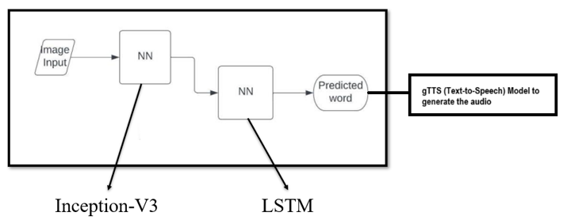
Architecture / Design

Slide 14
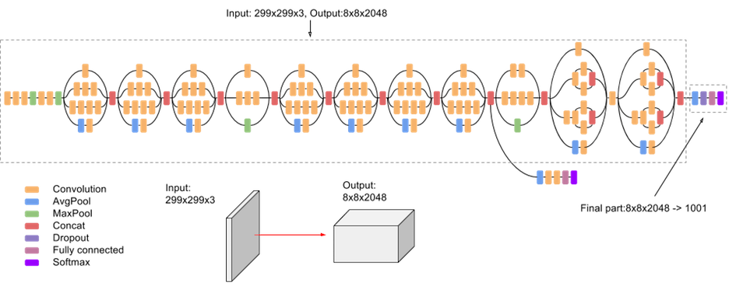
Inception V3
6,430,701 trainable parameters

Slide 15
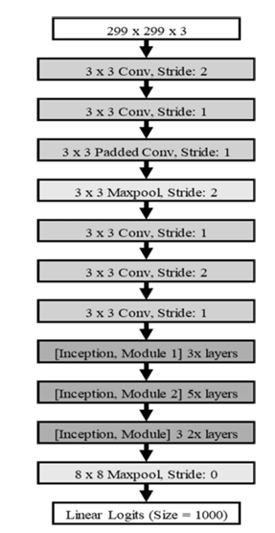
15

Slide 16
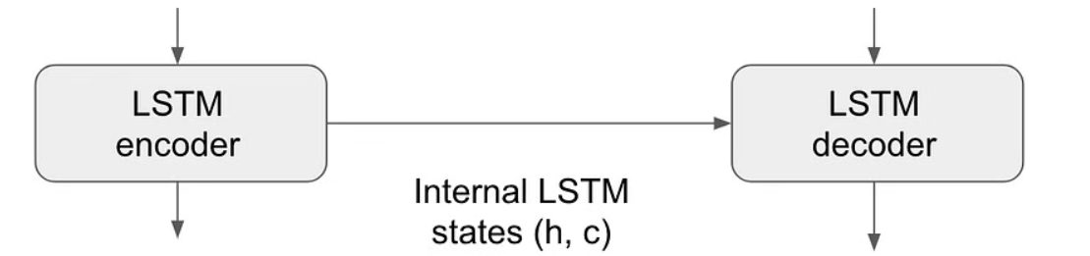

LSTM Architecture

Slide 17
Data Set
Dataset link : https://www.kaggle.com/datasets/awsaf49/flickr30k-dataset
FOR IMAGE CAPTIONING
The project uses the Flickr30k the dataset.
31,000 photos with five different captions each
Captions describe the key elements and actions in the image.
Sentence-based image description and search.
The pictures were hand-picked to represent a diversity of events and circumstances from six different Flickr groups, and they usually don't feature any famous individuals or places.
We integrate TTS model with the image captioning pipeline, after generating captions for images, then pass these captions to the TTS model to generate corresponding audio.

Slide 18
Implementation
Python Libraries:
NumPy, Pickle, TensorFlow, Keras
Tokenizer:
Key in natural language processing, dividing text into tokens for efficient processing.
Pre-processing the Image:
Utilizes InceptionV3 pre-trained model to extract meaningful features.
Resizes images strategically to 224x224 pixels without the need for classification.
Developing Vocabulary for the Image:
Text cleaning reduces vocabulary size and enhances coherence.
Curated lexicon of 8763 distinct words prepared for machine readability.

Slide 19
Implementation
Training the Model:
Dataset of 30000 training images undergoes 200 training epochs.
Pre-trained CNN model enhances the model's ability to craft meaningful captions.
BLEU’S Model Evaluation:
Bilingual Evaluation Understudy Score gauges similarity between generated and reference sentences.
Numerical representation (0.0 to 1.0) provides a detailed summary of model prowess in aligning captions.

Slide 20
Implementation
The Google Text-to-Speech (gTTS) library is integrated into the project as the final touch, acting as a captivating narrator for visually impaired users.
gTTS, a Python library, excels in text-to-speech synthesis, connecting seamlessly to Google Translate's TTS API.
It transforms textual captions into melodic audio, breathing life into visual narratives for the visually impaired.
The implementation involves invoking gTTS, providing generated captions as text, and creating audio files for an auditory companion.
This integration creates a harmonious convergence of text and voice, enhancing accessibility and inclusivity for the visually impaired.
gTTS serves as the concluding note, turning textual captions into a vocal masterpiece, breaking barriers in image understanding and sensory perception.

Slide 21
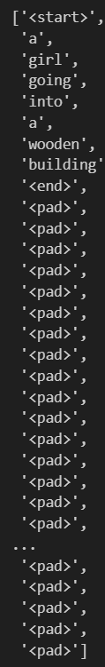
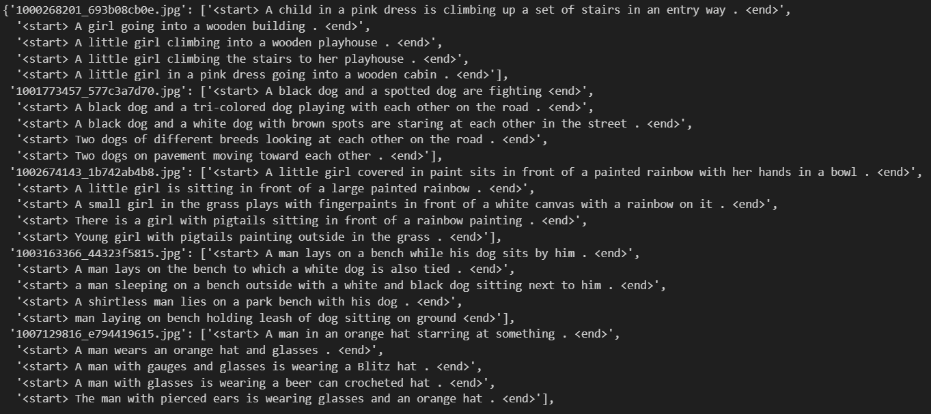

Slide 22
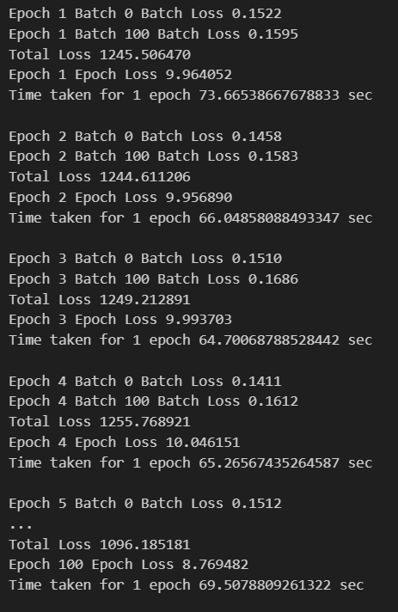

Slide 23
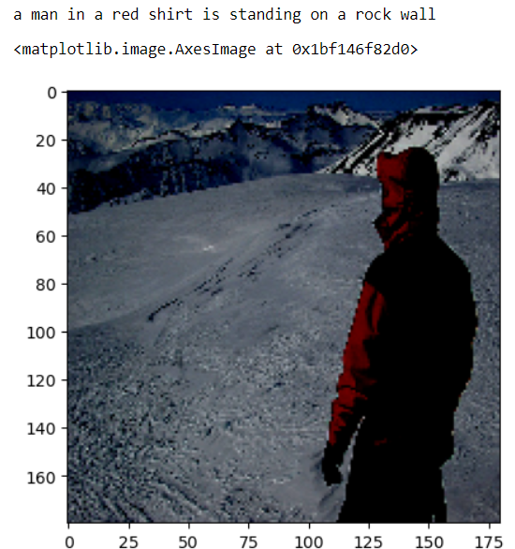
Final Result – Image Caption Generation
a man in a red shirt is standing on a rock wall

Slide 24
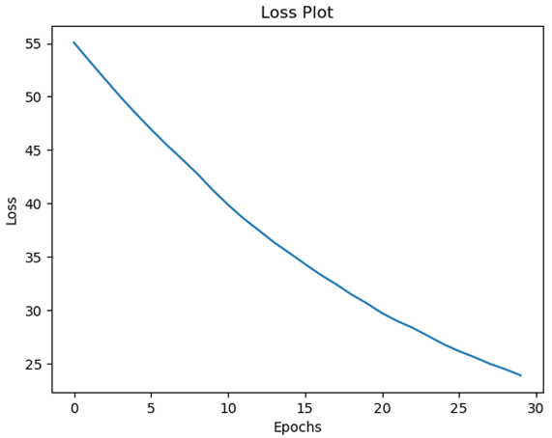
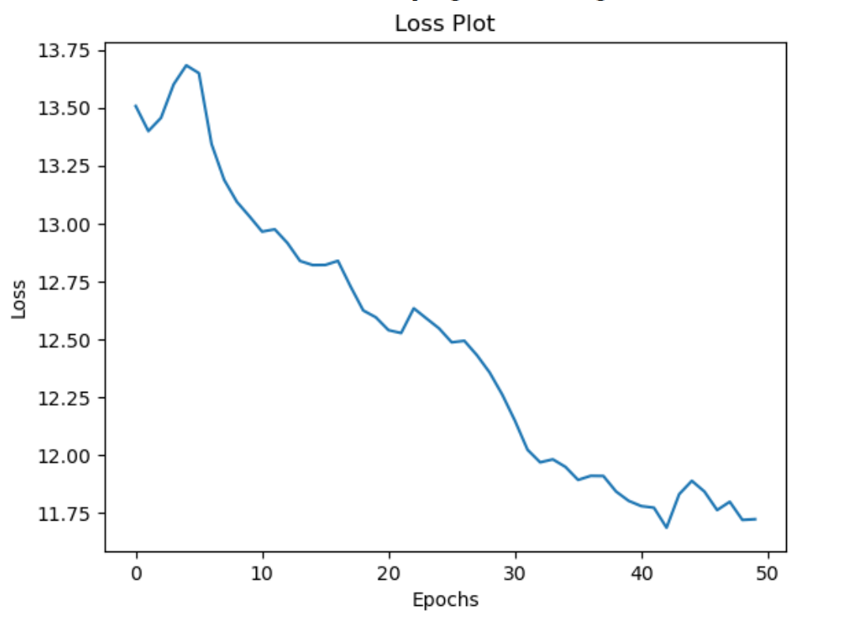
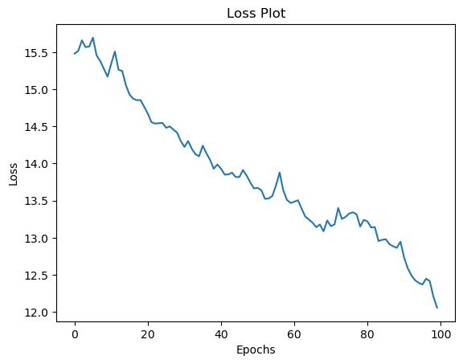
Loss Plots for 8K Dataset
30 Epochs
50 Epochs
100 Epochs

Slide 25
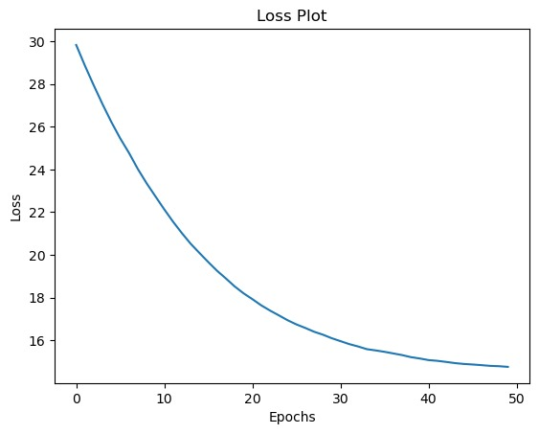
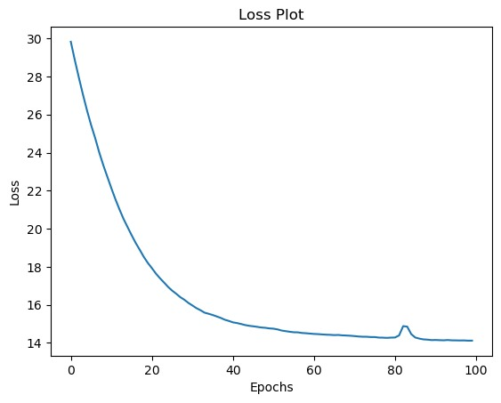
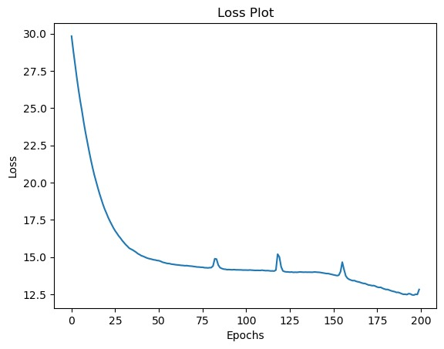
Loss Plots for 30K Dataset
50 Epochs
100 Epochs
200 Epochs

Slide 26
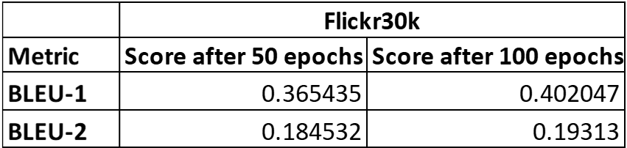
BLEU Scores

Slide 27
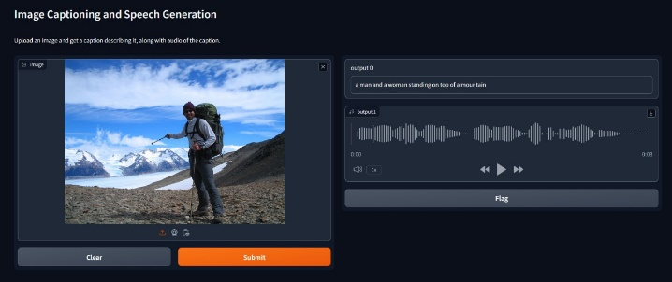
Real Time

Slide 28
Analysis from the Result
The consistent decrease in training loss throughout epochs indicates successful model learning and convergence, essential for accurate caption generation.
Monitoring changes in BLEU scores over epochs offers valuable insights into linguistic performance, enabling adjustments to improve caption quality.
Assessing factors like pronunciation accuracy and coherence of generated speech provides a qualitative measure of the system's effectiveness in converting captions to audio.
Comparing BLEU scores at different epoch intervals helps determine the ideal training duration, balancing model performance and computational resources.
Evaluating generated captions for contextual relevance and semantic accuracy provides nuanced insights into the system's proficiency and areas for refinement.

Slide 29
Timeline
Literature Survey
Abstract Submission
23/02/2024
10/03/2024
08/05/2024
Document Submission
26/04/2024
Testing
08/04/2024
Implementation
30/03/2024
Design [Neural Networks]

Slide 30
Challenges
Training and Testing
Computation Resources
Scalability and Efficiency
Diversity of Visual Content

Slide 31
Conclusion
Substantial advancement in addressing accessibility challenges for visually impaired individuals.
Compared to previous project, our approach excels in
We combine cutting-edge deep learning techniques, extensive dataset utilization, and user feedback to provide a more efficient and user-centric solution.
Offering visually impaired individuals a level of independence and inclusivity previously unattainable.
Enhancing the lives of the visually impaired community.
Accuracy
Quality and
Significantly better results, because of extensive dataset utilization
Notes:
"Image to Audio for Enhanced Accessibility," represents a substantial advancement in addressing accessibility challenges for visually impaired individuals. Compared to previous projects, our approach excels in accuracy, quality, and user satisfaction, promising significantly better results. We combine cutting-edge deep learning techniques, extensive dataset utilization, and user feedback to provide a more efficient and user-centric solution.
Our dedication to continuous improvement ensures we remain at the forefront of accessibility technology, offering visually impaired individuals a level of independence and inclusivity previously unattainable.
In essence, our project sets new standards for digital accessibility, providing superior results and enhancing the lives of the visually impaired community.

Slide 32
References
[1] R. Sriram, R. Haralalka and J. R, "Image to Audio Captioning for the Visually Impaired," 2023
International Conference on Recent Advances in Science and Engineering Technology
(ICRASET), B G NAGARA, India, 2023, pp. 1-5, doi:10.1109/ICRASET59632.2023.10420357.
[2] E. Mulyanto, E. I. Setiawan, E. M. Yuniarno and M. H. Purnomo, "Automatic
Indonesian Image Caption Generation using CNN-LSTM Model and FEEH-ID
Dataset," 2019 IEEE International Conference on Computational Intelligence and Virtual Environments for Measurement Systems and Applications (CIVEMSA), Tianjin, China, 2019, pp. 1-5, doi: 10.1109/CIVEMSA45640.2019.9071632.
[3] J. Sudhakar, V. V. Iyer and S. T. Sharmila, "Image Caption Generation using Deep
Neural Networks," 2022 International Conference for Advancement in Technology (ICONAT), Goa, India, 2022, pp. 1-3, doi: 10.1109/ICONAT53423.2022.9726074.
[4] S. Rao, S. Santhosh, K. Preethi Salian, T. Chidananda, Prathyakshini and S. Sandeep Kumar, "A Novel Approach to Generate the Captions for Images with Deep Learning using CNN and LSTM Model," 2022 International Conference on Distributed Computing, VLSI, Electrical Circuits and Robotics ( DISCOVER), Shivamogga, India, 2022, pp. 176-179, doi: 10.1109/DISCOVER55800.2022.9974750.

Slide 33
References
[5] R. K, S. N. K. N, S. A. R. S and K. G. R, "Deep Learning Based Voice Assistant for the Visually Impaired," 2021 Second International Conference on Electronics and Sustainable Communication Systems (ICESC), Coimbatore, India, 2021, pp. 1627-1633, doi: 10.1109/ICESC51422.2021.9532661.
[6] A. S. Alva, R. Nayana, N. Raza, G. S. Sampatrao and K. B. S. Reddy, "Object Detection and Video Analyser for the Visually Impaired," 2023 Third International Conference on Artificial Intelligence and Smart Energy (ICAIS), Coimbatore, India, 2023, pp. 1405-1412, doi: 10.1109/ICAIS56108.2023.10073662.
[7] V. V. N. V. Phani Kumar, V. Phani Teja, A. R. Kumar, V. Harshavardhan and U. Sahith, "Image Summarizer for the Visually Impaired Using Deep Learning," 2021 International Conference on System, Computation, Automation and Networking (ICSCAN), Puducherry, India, 2021, pp. 1-4, doi: 10.1109/ICSCAN53069.2021.9526465.
[8] F. Sharon, S. Sellamuthu, N. S and A. V, "Framework for Face recognition and Scene Description using Deep Learning for Visually Challenged people," 2023 International Conference on Emerging Research in Computational Science (ICERCS), Coimbatore, India, 2023, pp. 1-11, doi: 10.1109/ICERCS57948.2023.10434146.

Slide 34
References
[9] A. Uriti, D. P. Kakarla, D. Jinugu, K. N. Silla, K. T. V. N. S. Sai Krishna and C. Anilkumar, "A Survey on Generating Audio with Captions for a Live Video using Neural Networks," 2023 International Conference on Sustainable Communication Networks and Application (ICSCNA), Theni, India, 2023, pp. 1012-1019, doi: 10.1109/ICSCNA58489.2023.10370514.
[10] G. Sumathi, D. V, M. M and A. T. Raj, "A Dynamic System to Assist Vision for Visually Challenged," 2022 8th International Conference on Smart Structures and Systems (ICSSS), Chennai, India, 2022, pp. 1-5, doi: 10.1109/ICSSS54381.2022.9782184.
[11] A. Verma, H. Saxena, M. Jaiswal and P. Tanwar, "Intelligence Embedded Image Caption Generator using LSTM based RNN Model," 2021 6th International Conference on Communication and Electronics Systems (ICCES), Coimbatre, India, 2021, pp. 963-967, doi: 10.1109/ICCES51350.2021.9489253.
[12] Jafar A. Alzubi, Rachna Jain, Preeti Nagrath, Suresh Satapathy, Soham Taneja, Paras Gupta, Suresh Chandra Satapathy, Rashmi Agrawal, and Vicente García Díaz. 2021. Deep image captioning using an ensemble of CNN and LSTM based deep neural networks. J. Intell. Fuzzy Syst. 40, 4 (2021), 5761–5769. https://doi.org/10.3233/JIFS-189415.

Slide 35
References
[13] Singh and D. Vij, "CNN-LSTM based Social Media Post Caption Generator," 2022 2nd International Conference on Innovative Practices in Technology and Management (ICIPTM), Gautam Buddha Nagar, India, 2022, pp. 205-209, doi: 10.1109/ICIPTM54933.2022.9754189.
[14] P. Voditel, A. Gurjar, A. Pandey, A. Jain, N. Sharma and N. Dubey, "Image Captioning- A Deep Learning Approach Using CNN and LSTM Network," 2023 3rd International Conference on Pervasive Computing and Social Networking (ICPCSN), Salem, India, 2023, pp. 343-348, doi: 10.1109/ICPCSN58827.2023.00062.
[15] N. Indumathi, R. J. Divyalakshmi, J. Stalin, V. Ramachandran and P. Rajaram, "Apply Deep Learning-based CNN and LSTM for Visual Image Caption Generator," 2023 3rd International Conference on Advance Computing and Innovative Technologies in Engineering (ICACITE), Greater Noida, India, 2023, pp. 1586-1591, doi: 10.1109/ICACITE57410.2023.10183097.
[16] P. Waghmare, S. Shinde and J. Katti, "Image Captioning using Neural Network Model," 2022 International Conference on Smart Technologies and Systems for Next Generation Computing (ICSTSN), Villupuram, India, 2022, pp. 1-3, doi: 10.1109/ICSTSN53084.2022.9761320.

Slide 36
References
[17] H. Ning, X. Zheng, Y. Yuan, and X. Lu, "Audio description from image by modal translation network," in Neurocomputing, vol. 423, pp. 124-134, 2021, doi: 10.1016/j.neucom.2020.10.053.
[18] X. Wang, J. van der Hout, J. Zhu, M. Hasegawa-Johnson and O. Scharenborg, "Synthesizing Spoken Descriptions of Images," in IEEE/ACM Transactions on Audio, Speech, and Language Processing, vol. 29, pp. 3242-3254, 2021, doi: 10.1109/TASLP.2021.3120644.
[19] C. R. Jyothi, D. Harika, B. Supraja, and K. S. Prasanna, "Image to Audio for Visually Impaired," Int. J. Innov. Eng. Manag. Res., vol. X, no. X, pp. X-X, Mar. 2023, [Online]. Available: https://ssrn.com/abstract=4398143 or http://dx.doi.org/10.2139/ssrn.4398143.
[20] G. Sairam, M. Mandha, P. Prashanth and P. Swetha, "Image Captioning using CNN and LSTM," 4th Smart Cities Symposium (SCS 2021), Online Conference, Bahrain, 2021, pp. 274-277, doi: 10.1049/icp.2022.0356.

Slide 37
THANK YOU

